Slide 1
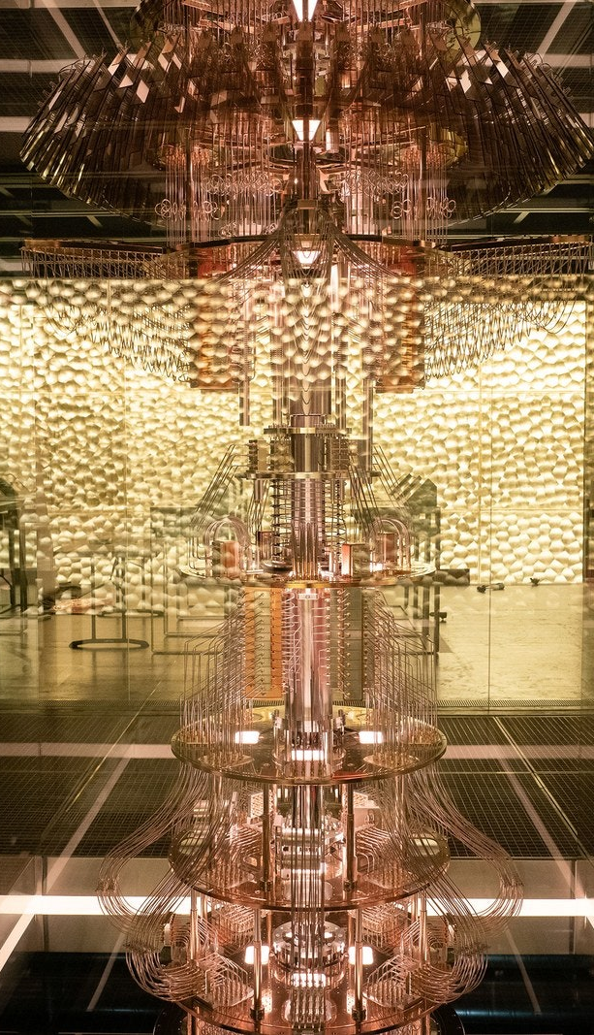
ITP 259: Basics of Artificial Intelligence Fall 2024 Lecture 9: Digit Classification with Scikit NN
Dr. Martin Prescher
Viterbi school of engineering

Slide 2
“Lily: She's not alive. She's a computer simulation. Forest: Explain the difference.”
- DEVS

Slide 3
Outline
Scikit learn neural network
Digit Classification using NN
Example: Classifying handwritten digits
Data preprocessing
Digit visualization
Hyper-Parameter Tuning

Slide 4

Scikit
Scikit-learn is a popular and extensive ML library (and we have used it this semester)
It also has modules for neural networks.
They are called multi-layer perceptron MLP.
Classification: Use the MLPClassifier
Regression: Use the MLPRegressor
https://scikit-learn.org/stable/modules/neural_networks_supervised.html
Recap the advantages of multi-layer NNs which can learn non-linear function between the inputs and outputs. The Universal Approximation Theorem guarantees that NNs can approximate any smooth function.
Recap the disadvantages of multi-layer NNs
The cost function curve can have several local minima. Different parameters can lead to different minima causing differing accuracy
Many parameters to iterate

Slide 5
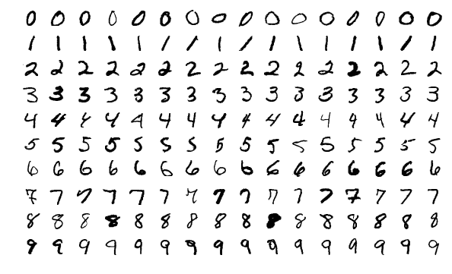
Classification of handwritten digits - MNIST
Standard benchmarking dataset from NIST – National Institute of Standards and Technology. M stands for modified.
It is a database of handwritten digits.
Used for training NN and testing accuracy.
Dataset contains 60,000 training images and 10,000 test images
The goal is to train a NN to read handwritten digits by classifying them from 0-9
By Josef Steppan - Own work, CC BY-SA 4.0, https://commons.wikimedia.org/w/index.php?curid=64810040

Slide 6
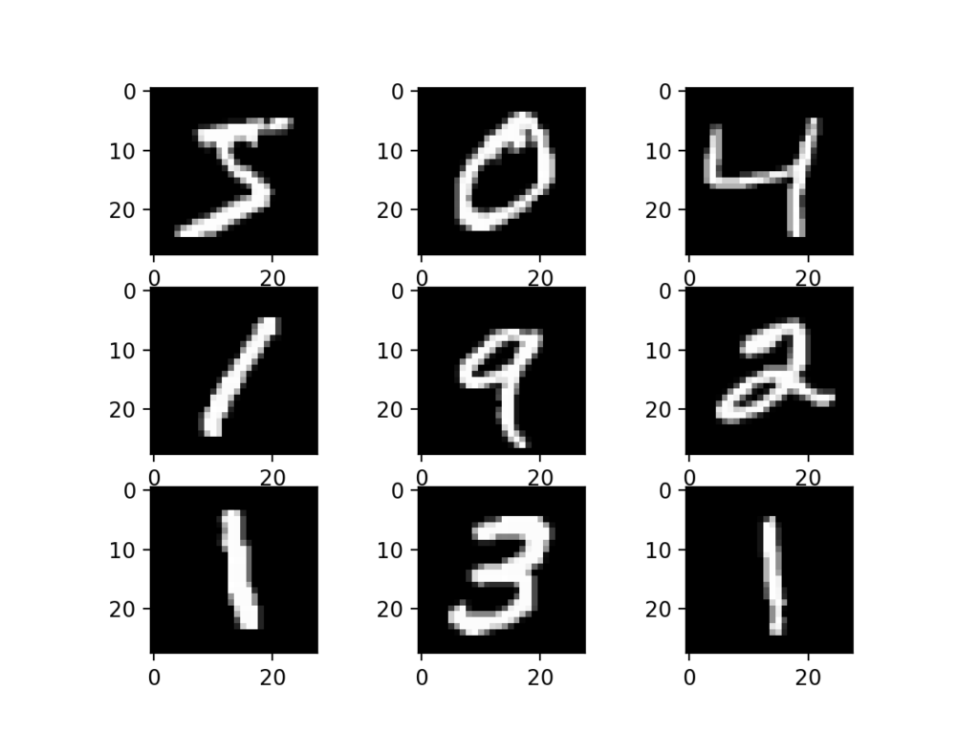
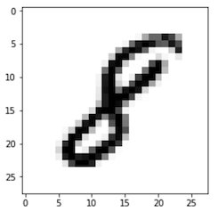
Digitization
Each image is 28x28 pixels.
The digits are 0-9
The images are grayscale. i.e. 8-bit (1 byte), 256 levels, 0-255

Slide 7
Pixel values after
0 | 0 | 0 | 0 | 0 | 0 | 0 | 0 | 0 | 0 | 0 | 0 | 0 | 0 | 0 | 0 | 0 | 0 | 0 | 0 | 0 | 0 | 0 | 0 | 0 | 0 | 0 | 0
0 | 0 | 0 | 0 | 0 | 0 | 0 | 0 | 0 | 0 | 0 | 0 | 0 | 0 | 0 | 0 | 0 | 0 | 0 | 0 | 0 | 0 | 0 | 0 | 0 | 0 | 0 | 0
0 | 0 | 0 | 0 | 0 | 0 | 0 | 0 | 0 | 0 | 0 | 0 | 0 | 0 | 0 | 0 | 0 | 0 | 0 | 0 | 0 | 0 | 0 | 0 | 0 | 0 | 0 | 0
0 | 0 | 0 | 0 | 0 | 0 | 0 | 0 | 0 | 0 | 0 | 0 | 0 | 0 | 0 | 0 | 0 | 0 | 0 | 0 | 0 | 0 | 0 | 0 | 0 | 0 | 0 | 0
0 | 0 | 0 | 0 | 0 | 0 | 0 | 0 | 0 | 0 | 0 | 0 | 0 | 0 | 0 | 0 | 0 | 0 | 0 | 0 | 0 | 0 | 0 | 0 | 0 | 0 | 0 | 0
0 | 0 | 0 | 0 | 0 | 0 | 0 | 0 | 0 | 0 | 0 | 0 | 0 | 0 | 0 | 0 | 0 | 0 | 0 | 11 | 203 | 229 | 32 | 0 | 0 | 0 | 0 | 0
0 | 0 | 0 | 0 | 0 | 0 | 0 | 0 | 0 | 0 | 0 | 0 | 0 | 0 | 0 | 26 | 47 | 47 | 30 | 95 | 254 | 215 | 13 | 0 | 0 | 0 | 0 | 0
0 | 0 | 0 | 0 | 0 | 0 | 0 | 0 | 0 | 0 | 0 | 45 | 154 | 185 | 185 | 223 | 253 | 253 | 133 | 175 | 255 | 188 | 19 | 0 | 0 | 0 | 0 | 0
0 | 0 | 0 | 0 | 0 | 0 | 0 | 0 | 0 | 0 | 0 | 110 | 253 | 253 | 253 | 246 | 161 | 228 | 253 | 253 | 254 | 92 | 0 | 0 | 0 | 0 | 0 | 0
0 | 0 | 0 | 0 | 0 | 0 | 0 | 0 | 0 | 0 | 128 | 245 | 253 | 158 | 137 | 21 | 0 | 48 | 233 | 253 | 233 | 8 | 0 | 0 | 0 | 0 | 0 | 0
0 | 0 | 0 | 0 | 0 | 0 | 0 | 0 | 0 | 0 | 139 | 254 | 223 | 25 | 0 | 0 | 36 | 170 | 254 | 244 | 106 | 0 | 0 | 0 | 0 | 0 | 0 | 0
0 | 0 | 0 | 0 | 0 | 0 | 0 | 0 | 0 | 0 | 55 | 212 | 253 | 161 | 11 | 26 | 178 | 253 | 236 | 113 | 0 | 0 | 0 | 0 | 0 | 0 | 0 | 0
0 | 0 | 0 | 0 | 0 | 0 | 0 | 0 | 0 | 0 | 7 | 155 | 253 | 228 | 80 | 223 | 253 | 253 | 109 | 0 | 0 | 0 | 0 | 0 | 0 | 0 | 0 | 0
0 | 0 | 0 | 0 | 0 | 0 | 0 | 0 | 0 | 0 | 0 | 141 | 253 | 253 | 253 | 254 | 253 | 154 | 29 | 0 | 0 | 0 | 0 | 0 | 0 | 0 | 0 | 0
0 | 0 | 0 | 0 | 0 | 0 | 0 | 0 | 0 | 0 | 0 | 110 | 253 | 253 | 253 | 254 | 179 | 38 | 0 | 0 | 0 | 0 | 0 | 0 | 0 | 0 | 0 | 0
0 | 0 | 0 | 0 | 0 | 0 | 0 | 0 | 0 | 0 | 3 | 171 | 254 | 254 | 254 | 179 | 0 | 0 | 0 | 0 | 0 | 0 | 0 | 0 | 0 | 0 | 0 | 0
0 | 0 | 0 | 0 | 0 | 0 | 0 | 0 | 0 | 0 | 171 | 253 | 253 | 253 | 253 | 178 | 0 | 0 | 0 | 0 | 0 | 0 | 0 | 0 | 0 | 0 | 0 | 0
0 | 0 | 0 | 0 | 0 | 0 | 0 | 0 | 26 | 123 | 254 | 253 | 203 | 156 | 253 | 200 | 0 | 0 | 0 | 0 | 0 | 0 | 0 | 0 | 0 | 0 | 0 | 0
0 | 0 | 0 | 0 | 0 | 0 | 0 | 0 | 93 | 253 | 254 | 121 | 13 | 93 | 253 | 158 | 0 | 0 | 0 | 0 | 0 | 0 | 0 | 0 | 0 | 0 | 0 | 0
0 | 0 | 0 | 0 | 0 | 0 | 0 | 64 | 239 | 253 | 76 | 8 | 32 | 219 | 253 | 126 | 0 | 0 | 0 | 0 | 0 | 0 | 0 | 0 | 0 | 0 | 0 | 0
0 | 0 | 0 | 0 | 0 | 0 | 0 | 133 | 254 | 191 | 0 | 5 | 108 | 234 | 254 | 106 | 0 | 0 | 0 | 0 | 0 | 0 | 0 | 0 | 0 | 0 | 0 | 0
0 | 0 | 0 | 0 | 0 | 0 | 0 | 132 | 253 | 190 | 5 | 85 | 253 | 236 | 154 | 0 | 0 | 0 | 0 | 0 | 0 | 0 | 0 | 0 | 0 | 0 | 0 | 0
0 | 0 | 0 | 0 | 0 | 0 | 0 | 153 | 253 | 169 | 192 | 253 | 253 | 77 | 0 | 0 | 0 | 0 | 0 | 0 | 0 | 0 | 0 | 0 | 0 | 0 | 0 | 0
0 | 0 | 0 | 0 | 0 | 0 | 0 | 112 | 253 | 253 | 254 | 236 | 129 | 9 | 0 | 0 | 0 | 0 | 0 | 0 | 0 | 0 | 0 | 0 | 0 | 0 | 0 | 0
0 | 0 | 0 | 0 | 0 | 0 | 0 | 17 | 118 | 243 | 191 | 113 | 0 | 0 | 0 | 0 | 0 | 0 | 0 | 0 | 0 | 0 | 0 | 0 | 0 | 0 | 0 | 0
0 | 0 | 0 | 0 | 0 | 0 | 0 | 0 | 0 | 0 | 0 | 0 | 0 | 0 | 0 | 0 | 0 | 0 | 0 | 0 | 0 | 0 | 0 | 0 | 0 | 0 | 0 | 0
0 | 0 | 0 | 0 | 0 | 0 | 0 | 0 | 0 | 0 | 0 | 0 | 0 | 0 | 0 | 0 | 0 | 0 | 0 | 0 | 0 | 0 | 0 | 0 | 0 | 0 | 0 | 0
0 | 0 | 0 | 0 | 0 | 0 | 0 | 0 | 0 | 0 | 0 | 0 | 0 | 0 | 0 | 0 | 0 | 0 | 0 | 0 | 0 | 0 | 0 | 0 | 0 | 0 | 0 | 0
digit viz.xlsx on Blackboard

Slide 8
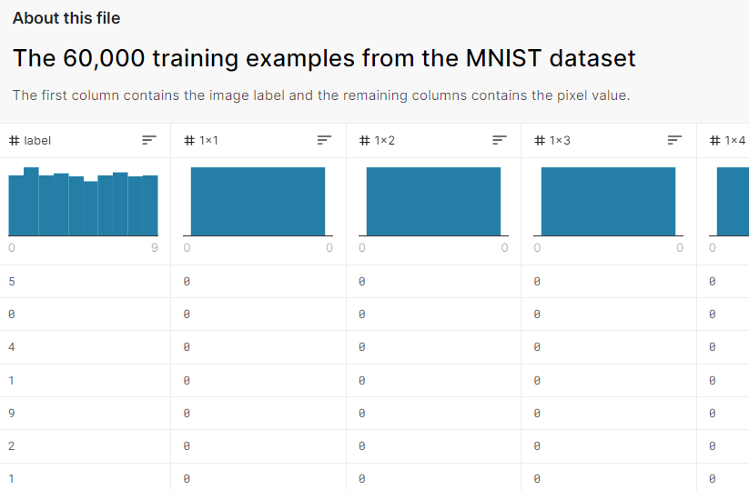
Dataset
MNIST dataset is available here - http://yann.lecun.com/exdb/mnist/
But it needs parsing
Here is the parsed dataset in csv format - https://www.kaggle.com/oddrationale/mnist-in-csv and on Blackboard
Details about csv

Slide 9
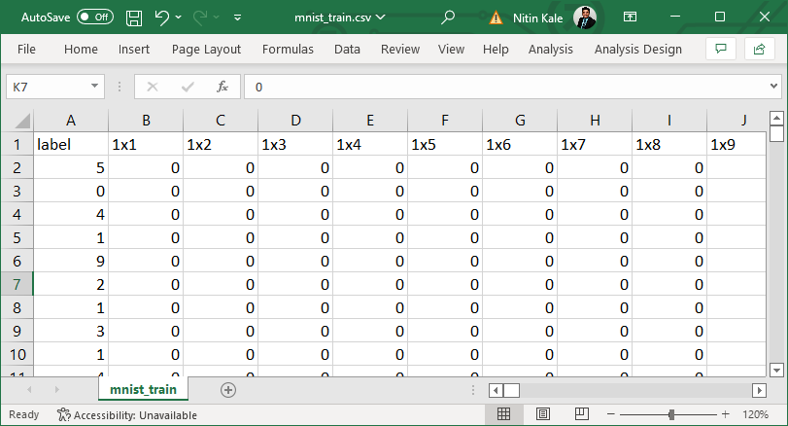
Explore the CSV file
The first column is the label – response variable. In this case, it is the digit that has been labeled (by humans). 0-9
Then there are m = 28x28 = 784 columns representing each pixel (features).
Each row is one image, one digit represented as 784 pixels. There are a total of n = 60,000 rows (data points).
The header of the csv file is :
Label, 1x1, 1x2, 1x3 …
ie. Label, pix-11, pix-12, pix-13
Where pix-ij is the pixel in the ith row and jth column
The value in each pixel is the grayscale 0-255.
0 can be white (or black), and 255 can be black (or white)

Slide 10
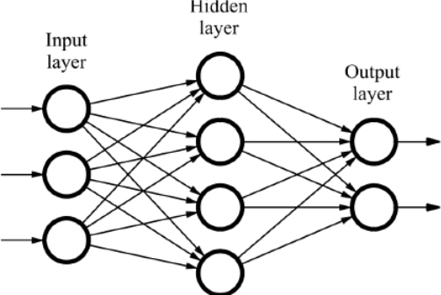
MLPClassifier
Let’s write code to
Import the training and test datasets.
Explore the dataset (histograms)
Visualize a few digits.
Train using MLPClassifier
Plot the loss curve (this is cross entropy loss)
Accuracy on the test dataset
Finally, have the trained model read a handwritten digit
8

Slide 11
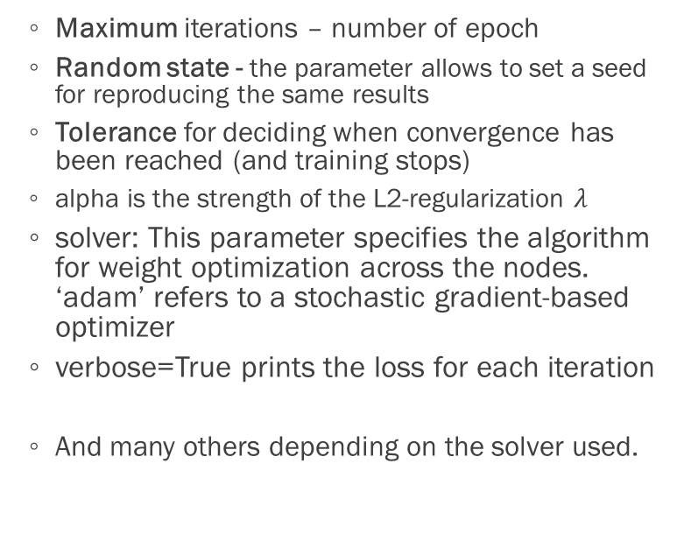
Quick Recap MLPClassifier
Multi-layer Perceptron Classifier as used in the previous lecture (mind the misnomer)
Offers the following parameters
Number of hidden layers
Number of neurons per layer
Activation functions
Tanh
ReLU
Sigmoid
Identity (linear)
Regularization rate
Batch size
Learning Rate
Maximum iterations – number of epoch
Random state - the parameter allows to set a seed for reproducing the same results
Tolerance for deciding when convergence has been reached (and training stops)
alpha is the strength of the L2-regularization $λ$
solver: This parameter specifies the algorithm for weight optimization across the nodes. ‘adam’ refers to a stochastic gradient-based optimizer
verbose=True prints the loss for each iteration
And many others depending on the solver used.

Slide 12
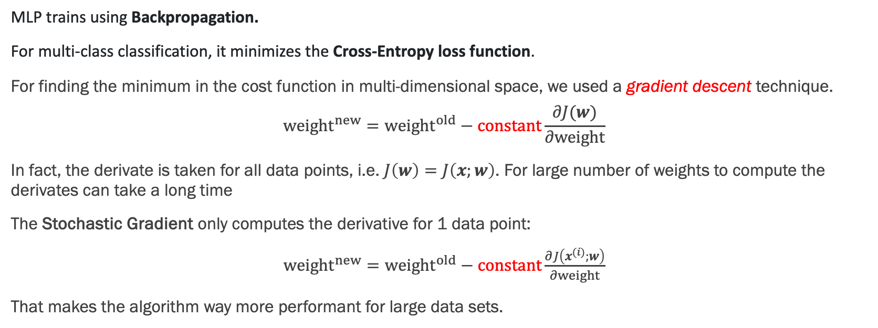
Inner workings of MLPClassifier
MLP trains using Backpropagation.
For multi-class classification, it minimizes the Cross-Entropy loss function.
For finding the minimum in the cost function in multi-dimensional space, we used a gradient descent technique.
$${weight}^{new}={weight}^{old}−constant\frac{∂J(w)}{∂weight}$$
In fact, the derivate is taken for all data points, i.e. $J\left(w\right)=J\left(x;w\right)$. For large number of weights to compute the derivates can take a long time
The Stochastic Gradient only computes the derivative for 1 data point:
${weight}^{new}={weight}^{old}−constant\frac{∂J\left(x^{(i)};w\right)}{∂weight}$
That makes the algorithm way more performant for large data sets.

Slide 13
Inner workings of MLPClassifier
MLPClassifier supports multi-class classification using Softmax as the output function
There are other options for the final output, like passing the raw output through a logistic function and round values > 0.5 to 1, otherwise to 0. For reference go here: https://scikit-learn.org/stable/modules/neural_networks_supervised.html
All in all, MLP uses all the techniques we’ve learned:
Cross Entropy Loss for multi-class classification
Backpropagation
Gradient descent
Softmax in the output

Slide 14
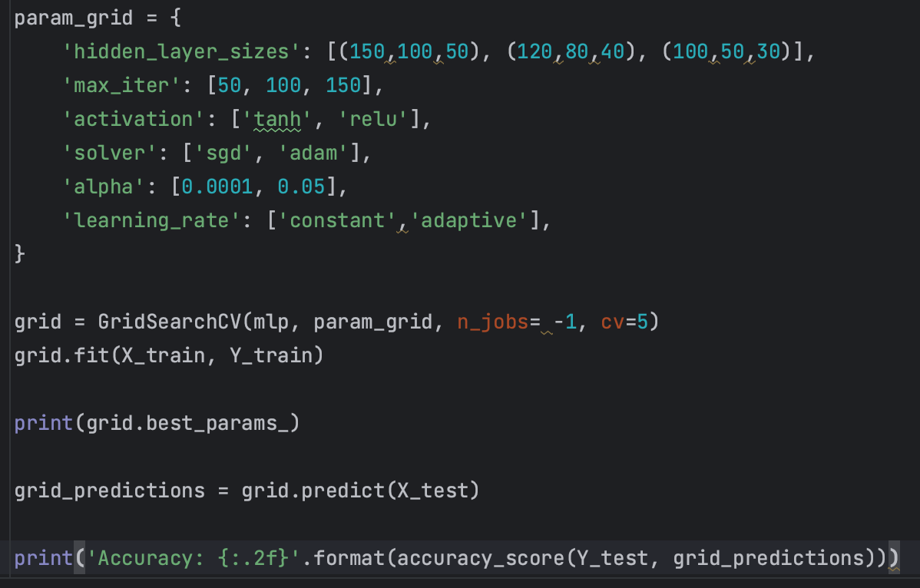
Hyper Parameter Tuning
We can run a variety of parameter combinations using GridSearchCV

Slide 15
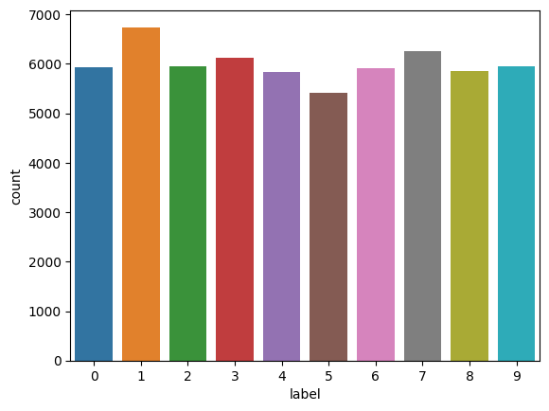
Countplot
First we do a countplot to see if we have somewhat uniform representation of all possible digits.
Countplot of labels (digits) does not seem to be skewed
The digits are more or less uniformly distributed

Slide 16
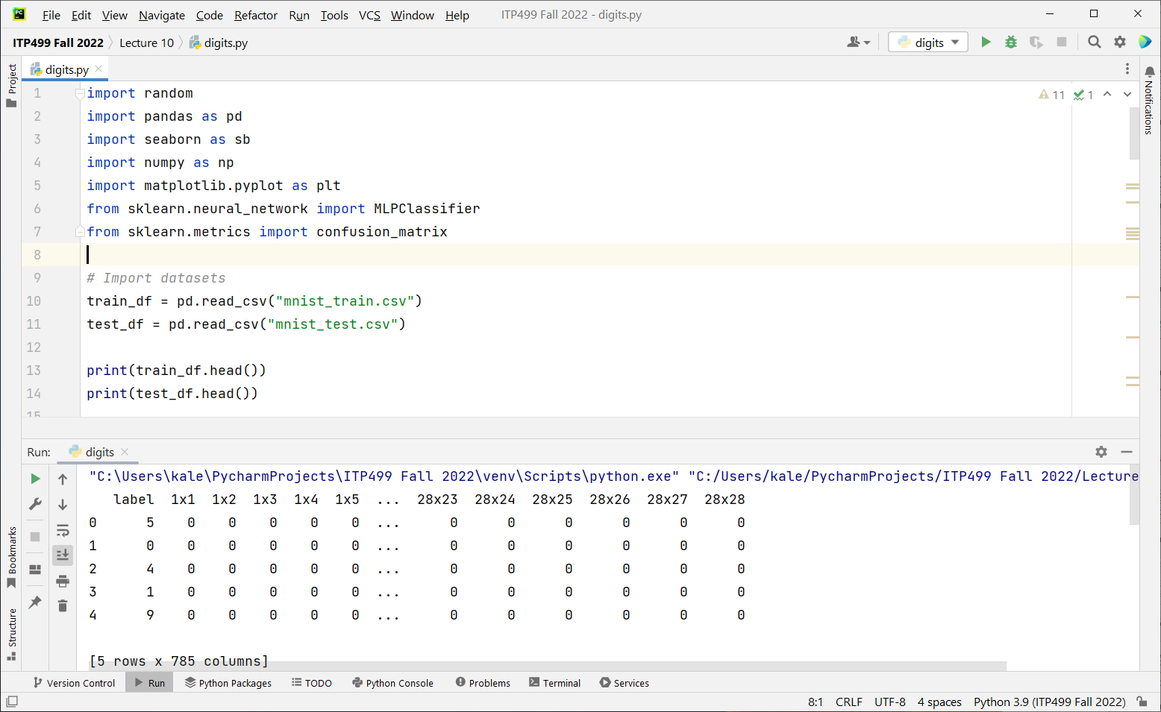

Slide 17
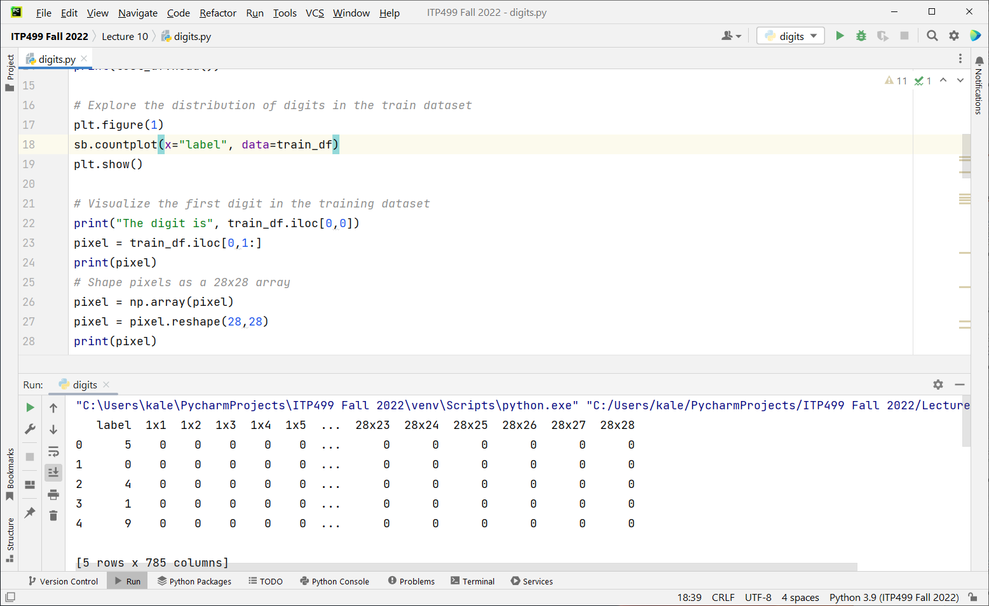

Slide 18
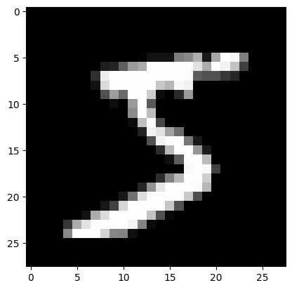
Visualization
We would like to visualize the digits to get a sense of how the handwritten digits look. Some preprocessing has been done to center them. Also make them similarly sized. They have been made upright.
Each row of 1 label and 784 columns represents one digit in the dataset
We can convert that to a 28x28 array
Then plot it.

Slide 19
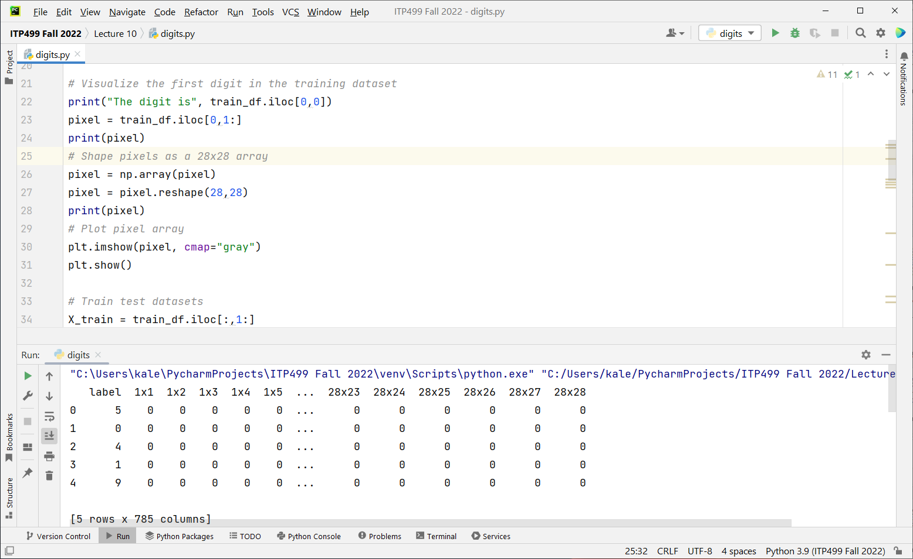

Slide 20
Data preparation
We will now prepare the train and test datasets
As always: separate the response vector from the features: X and y
60,000 training samples
10,000 test samples
The partitions are already available as two separate csv files: train and test
X_train, Y_train, X_test, Y_test
(60000, 784) (60000,) (10000, 784) (10000,)

Slide 21
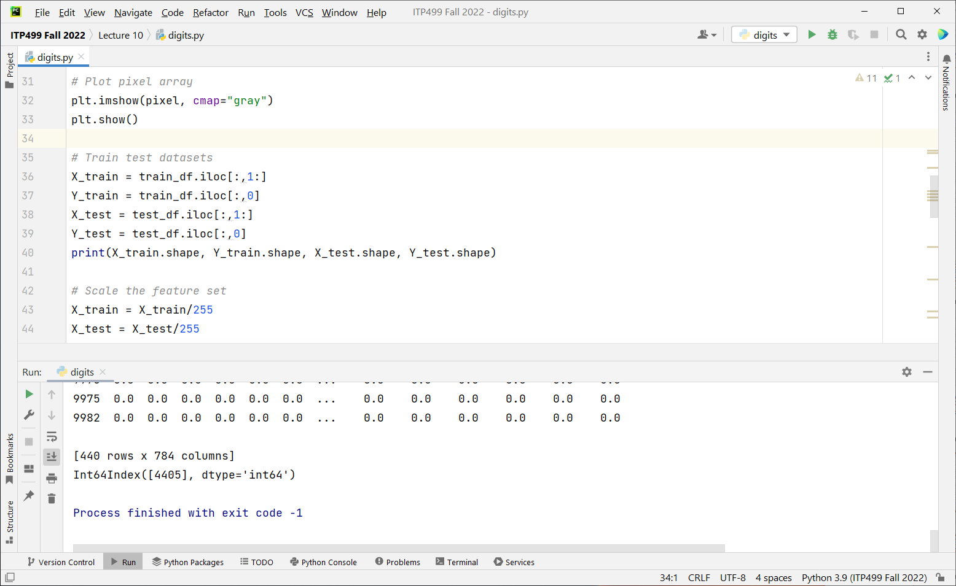

Slide 22
Scale X
We will scale X_train and X_test (0 to 1) for faster training.
Since the range of pixel values is 0 to 255, we can divide by 255 to scale the feature dataset

Slide 23
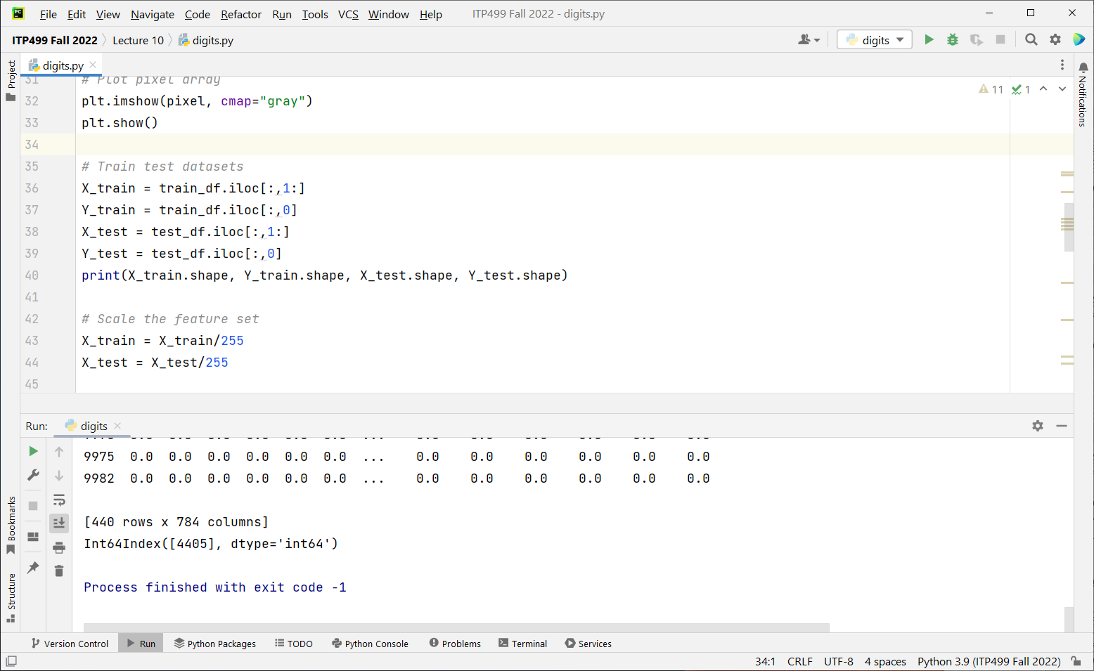

Slide 24
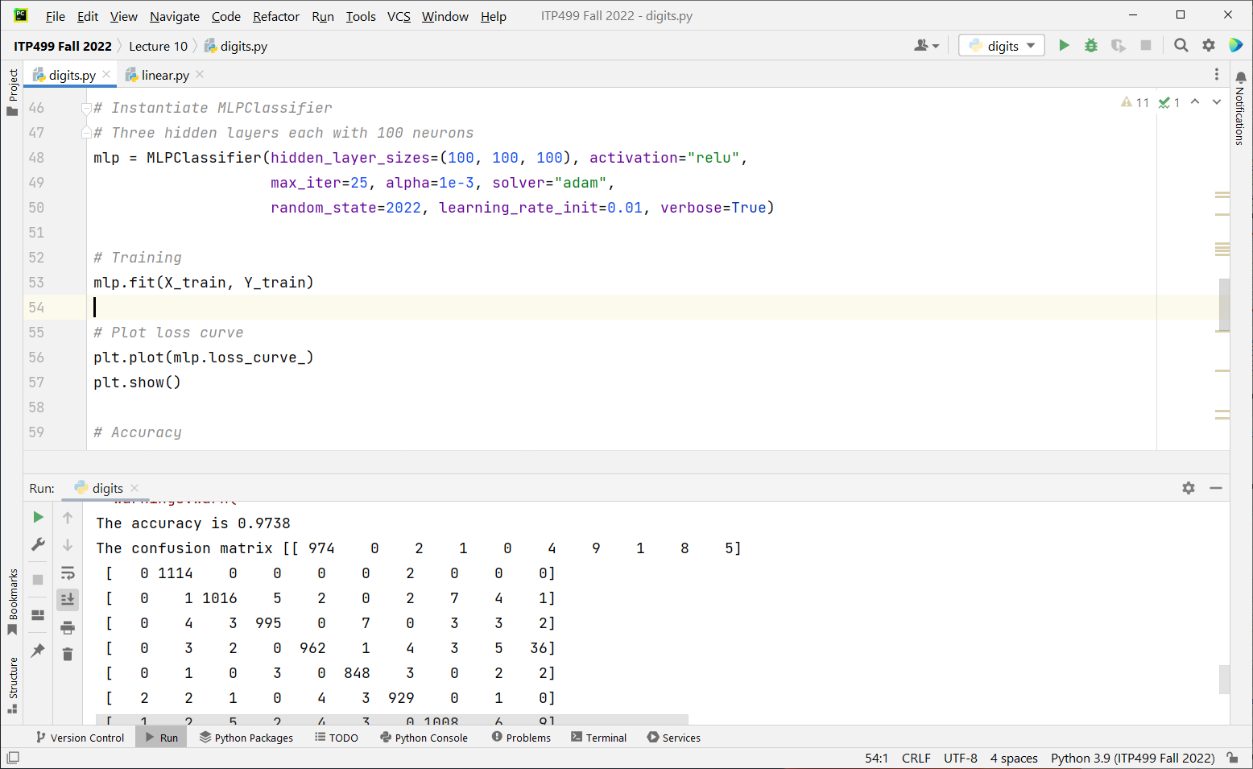

Slide 25
Training and testing
Train the model
Plot the loss curve
Then test it and compute accuracy
Print the confusion matrix
And finally predict for a sample digit
Display the digit image and the prediction for it
Training in progress. Try various parameters…
Iteration 1, loss = 0.26667382
Iteration 2, loss = 0.13225395
Iteration 3, loss = 0.11105920
Iteration 4, loss = 0.10009267
Iteration 5, loss = 0.09020111
Iteration 6, loss = 0.08306008
Iteration 7, loss = 0.08433523

Slide 26
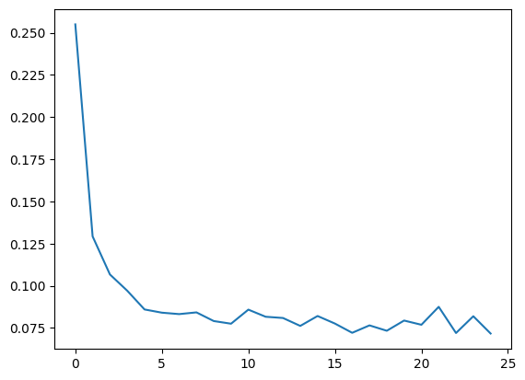
Loss curve

Slide 27
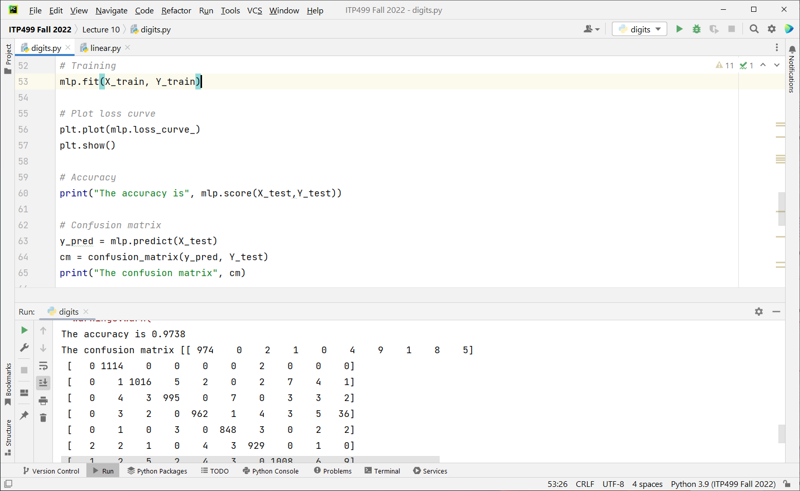

Slide 28
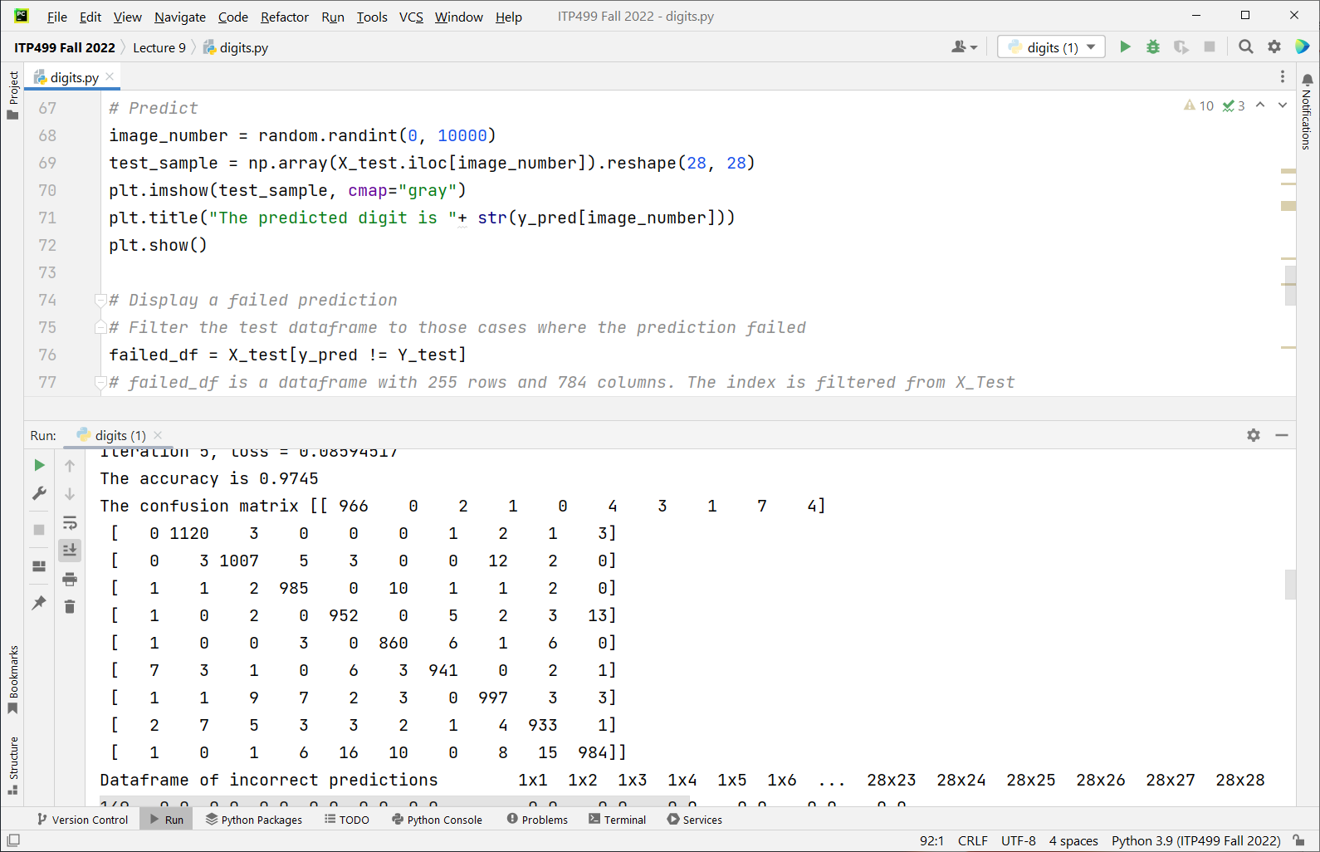

Slide 29
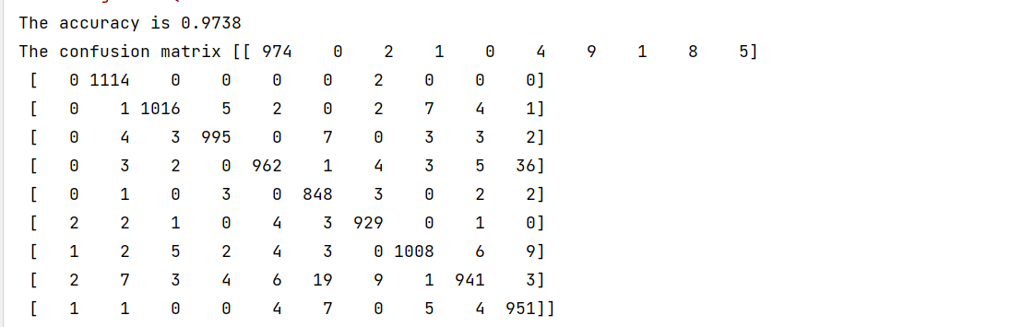
Confusion Matrix

Slide 30
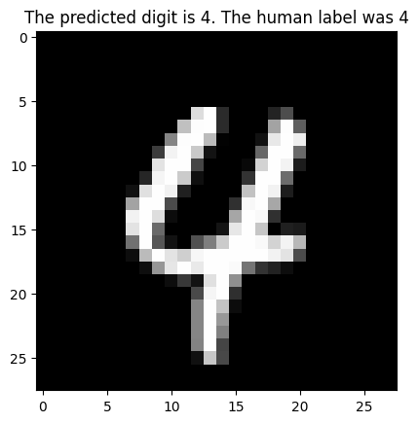

Slide 31
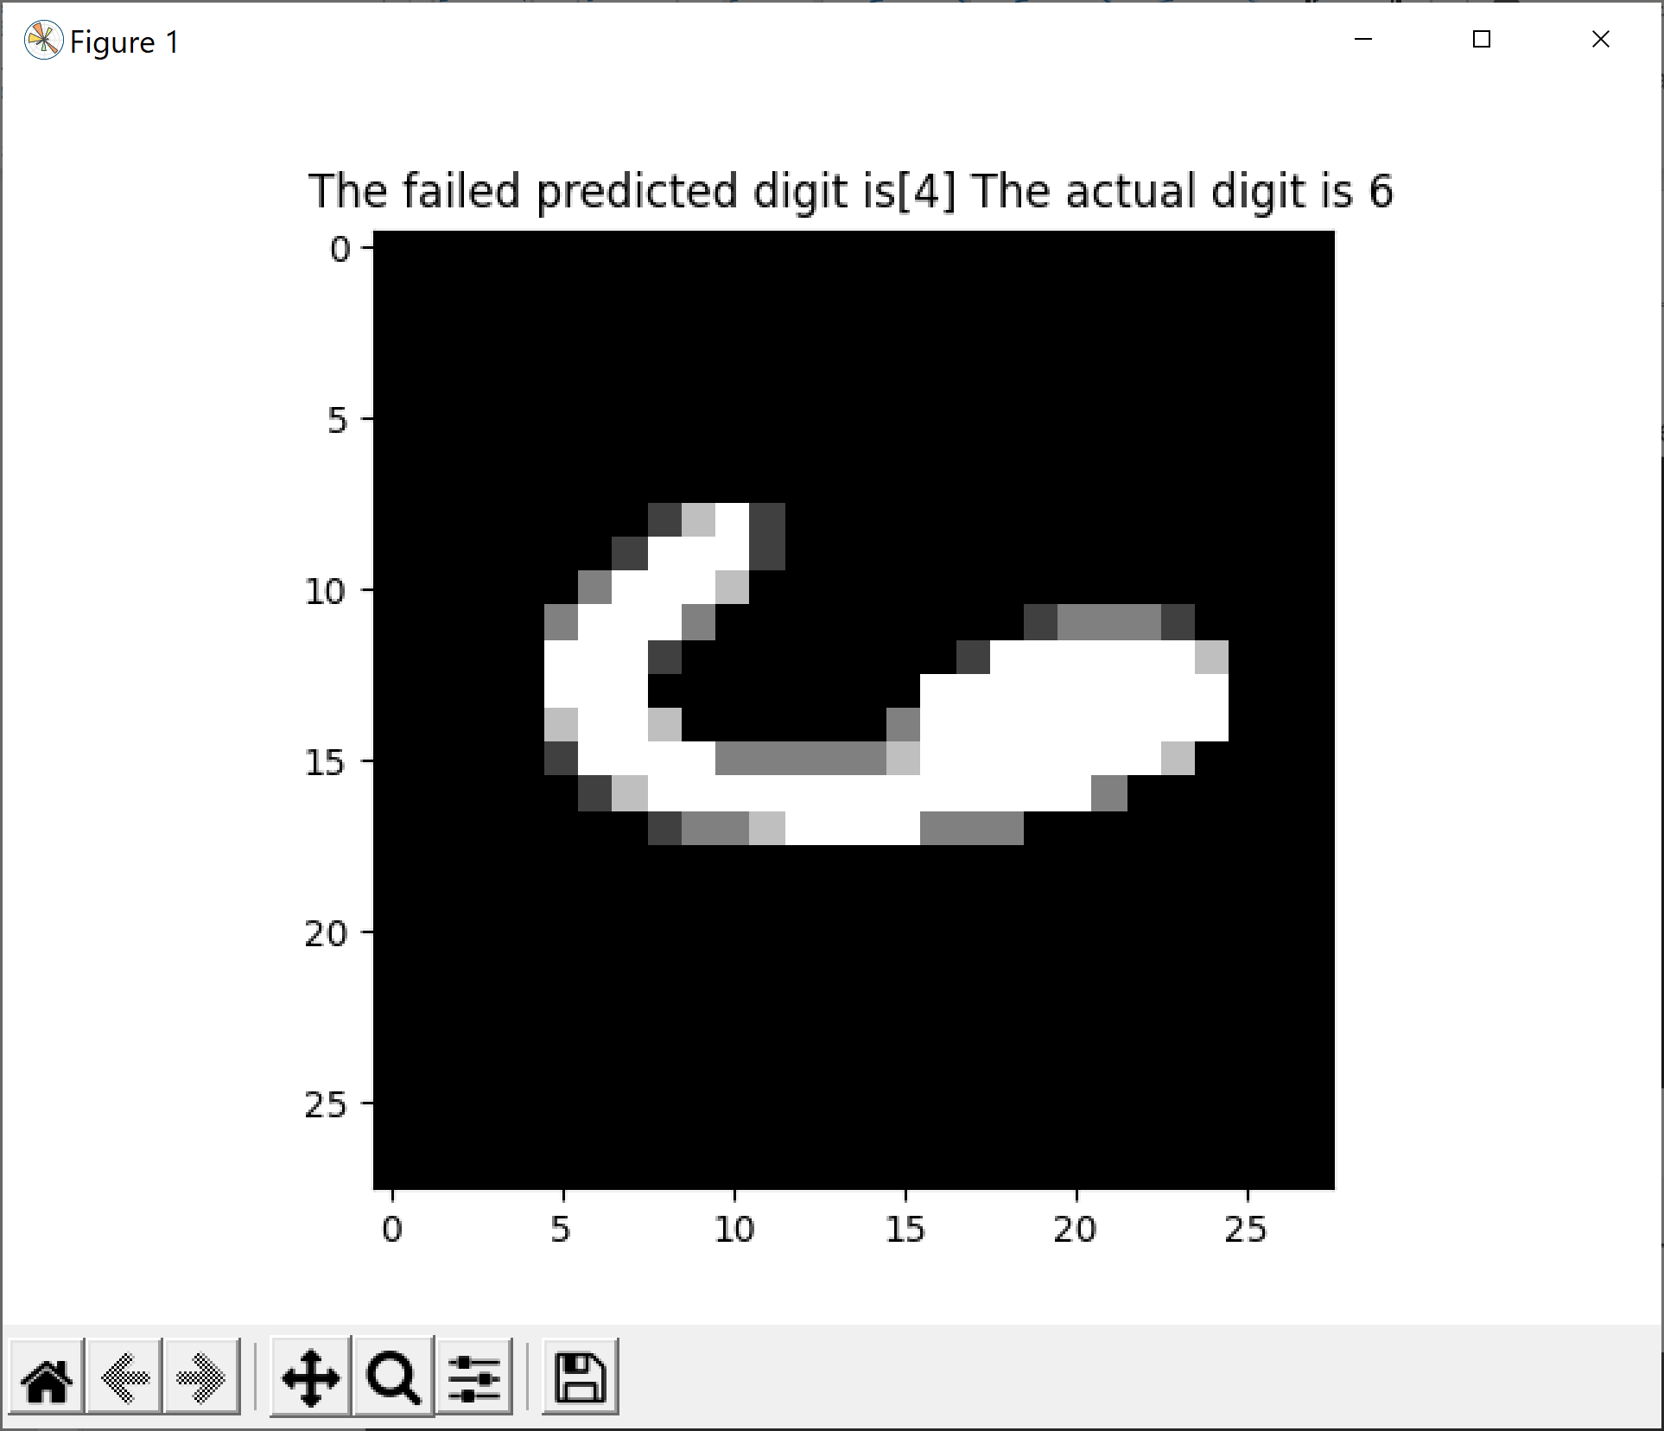
Find a misclassified digit
Although the accuracy of the model is quite high, the confusion matrix shows misclassifications
On your own, find a test case that the MLP did not classify correctly
Do you think that a human would have classified it correctly?

Slide 32
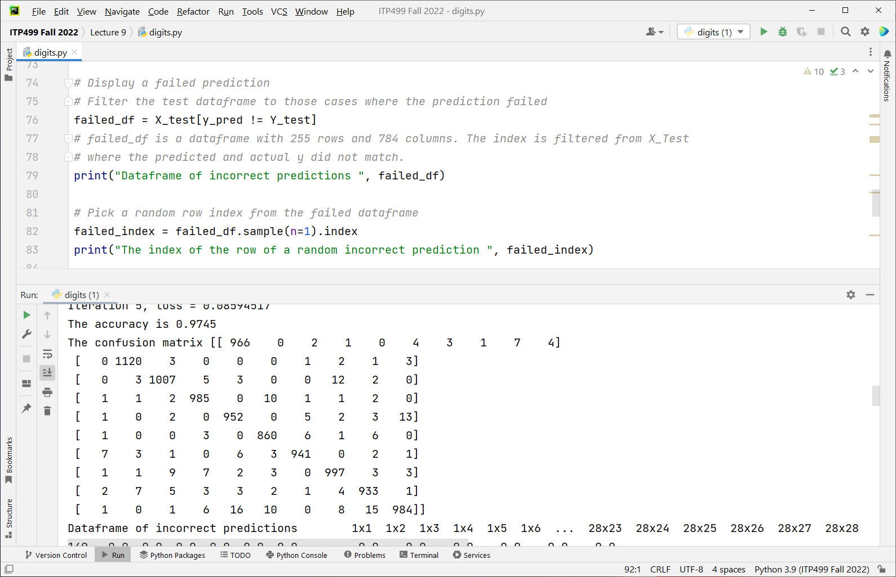

Slide 33
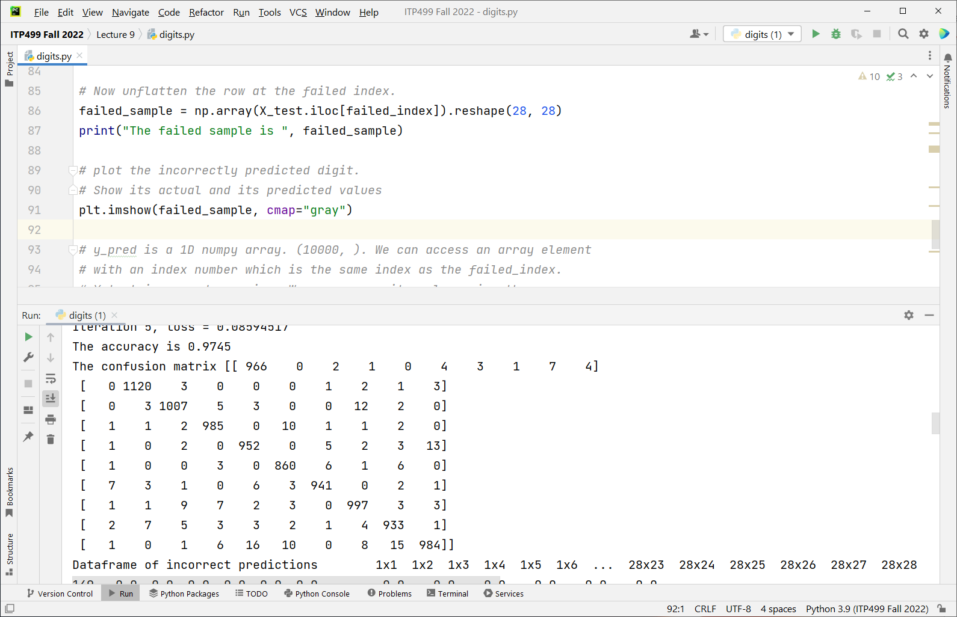

Slide 34
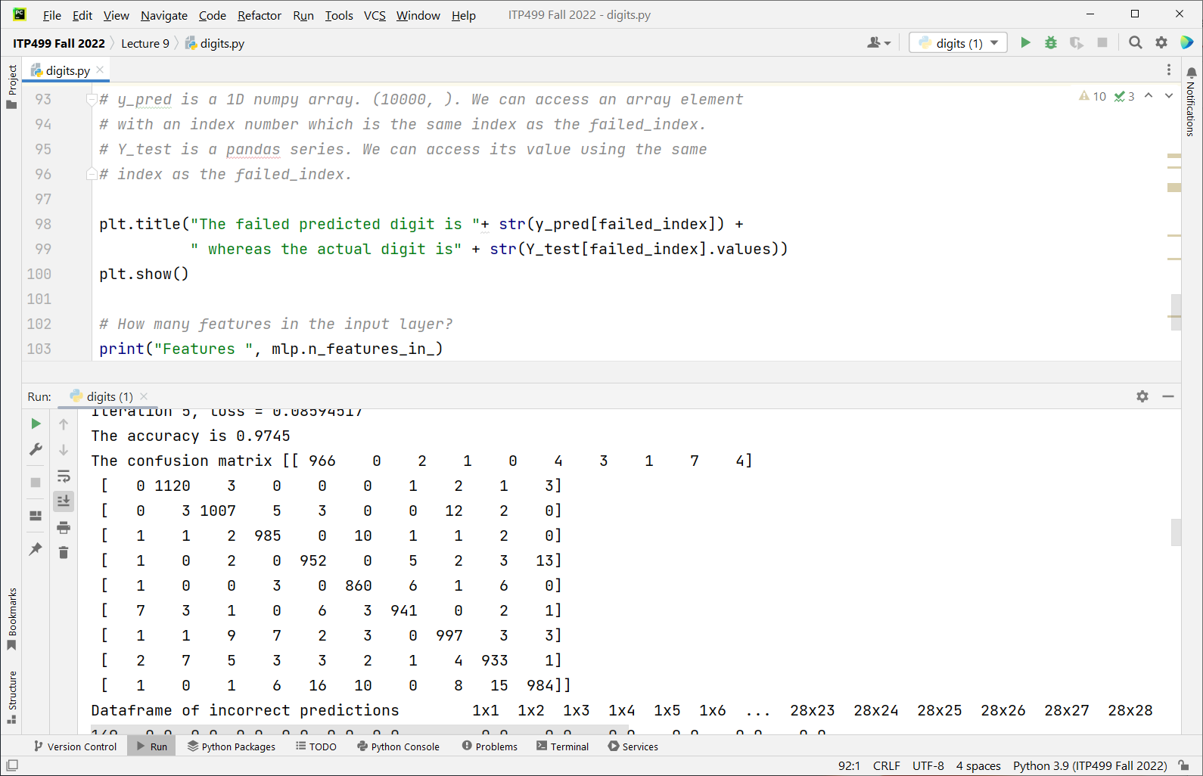

Slide 35
Observations
Questions about the NN
How many features in the input layer? 28 x 28 = 784
How many hidden layers? 3
How many neurons per hidden layer? 100, 100, 100
How many neurons in the output layer? 10
Estimate of number of parameters of the entire NN.
Weights (784 x 100 + 100 x 100 + 100 x 100 + 100 x 10) + biases (100 + 100 + 100 + 10)
= 99710

Slide 36
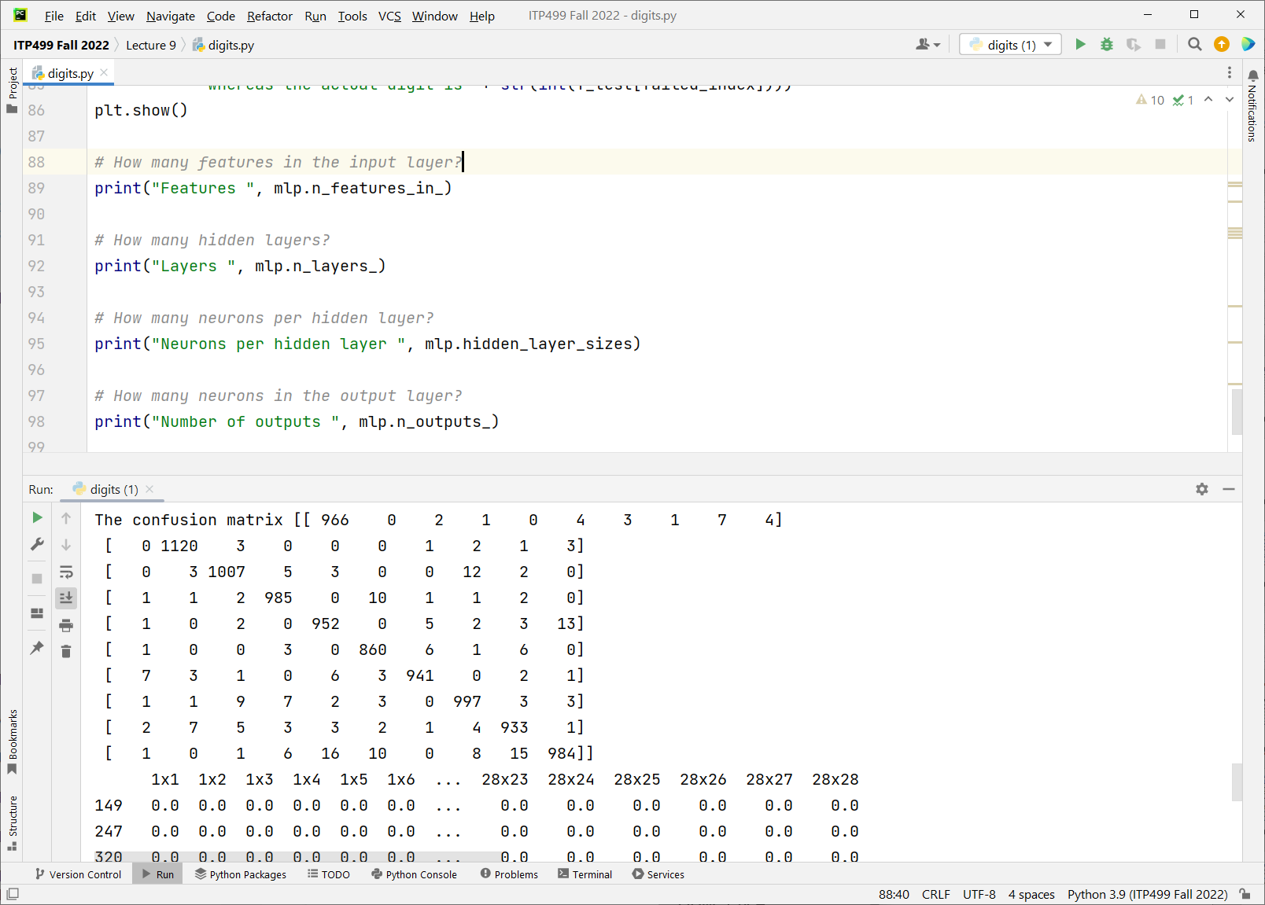

Slide 37
Disadvantages of MLPClassifier for digits
Sensitive to initial conditions (the starting values of weights). It may converge to a local minima. Differing accuracies.
The input image 28x28 is flattened so the NN loses the spatial relationships between adjacent pixels of the image.
The layers are fully connected. Which means each pixel in the input layer is connected to all neurons in hidden layer 1. Every neuron in hidden layer 1 is connected to each neuron in layer 2 etc. This leads to a very large number of weights to be adjusted for large images e.g. 1000 p x 1000 p
If the digits are not centered, not upright, not the same approx. size, the model has poor performance.
We will address these in the next lecture on Convolution Neural Networks CNN

Slide 38
Summary
We learned how do train a neural network to recognize handwritten digits
We achieved remarkably high accuracy
There are other considerations such as rotated letters, colors, noisy background (think of captcha) etc.

